Slide 1
Building Like Amazon
DevOps, Culture, Automation
<Presenter>
<Title>
<Title>

Slide 2
Why are you here?
So you can answer your customer (correctly) when they ask, “How does Amazon do it?”
You want to build trust
Your customers need to transform
Your customers are just starting out
You want to talk to your customer about something more than “Cloud”
You heard “DevOps” was the way to go
Your customers are not moving fast enough
Everything else was full

Slide 3


















Powerful ecosystem of tools
CI/CD Tools
Infrastructure as Code
IDE
Monitoring & Tracing
Web Apps
AWS CodeStar
AWS CodeBuild
AWS CodeCommit
AWS CodeDeploy
AWS CodePipeline
AWS CloudFormation
AWS Cloud Dev. Kit (CDK)
AWS Cloud9
AWS X-Ray
Amazon CloudWatch
AWS Elastic Beanstalk
IDE and DevOps Toolkits
CLI and Scripting Tools
Languages
Mobile
Amazon Corretto
AWS Amplify
Visual Studio Code
IntelliJ
PyCharm
Visual Studio
Eclipse
VSTS
AWS CLI
Tools for PowerShell
SDKs
JavaScript
Python
PHP
.NET
Ruby
Java
Go
Node.js
C++

Slide 4









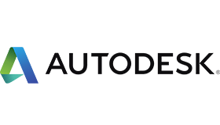






















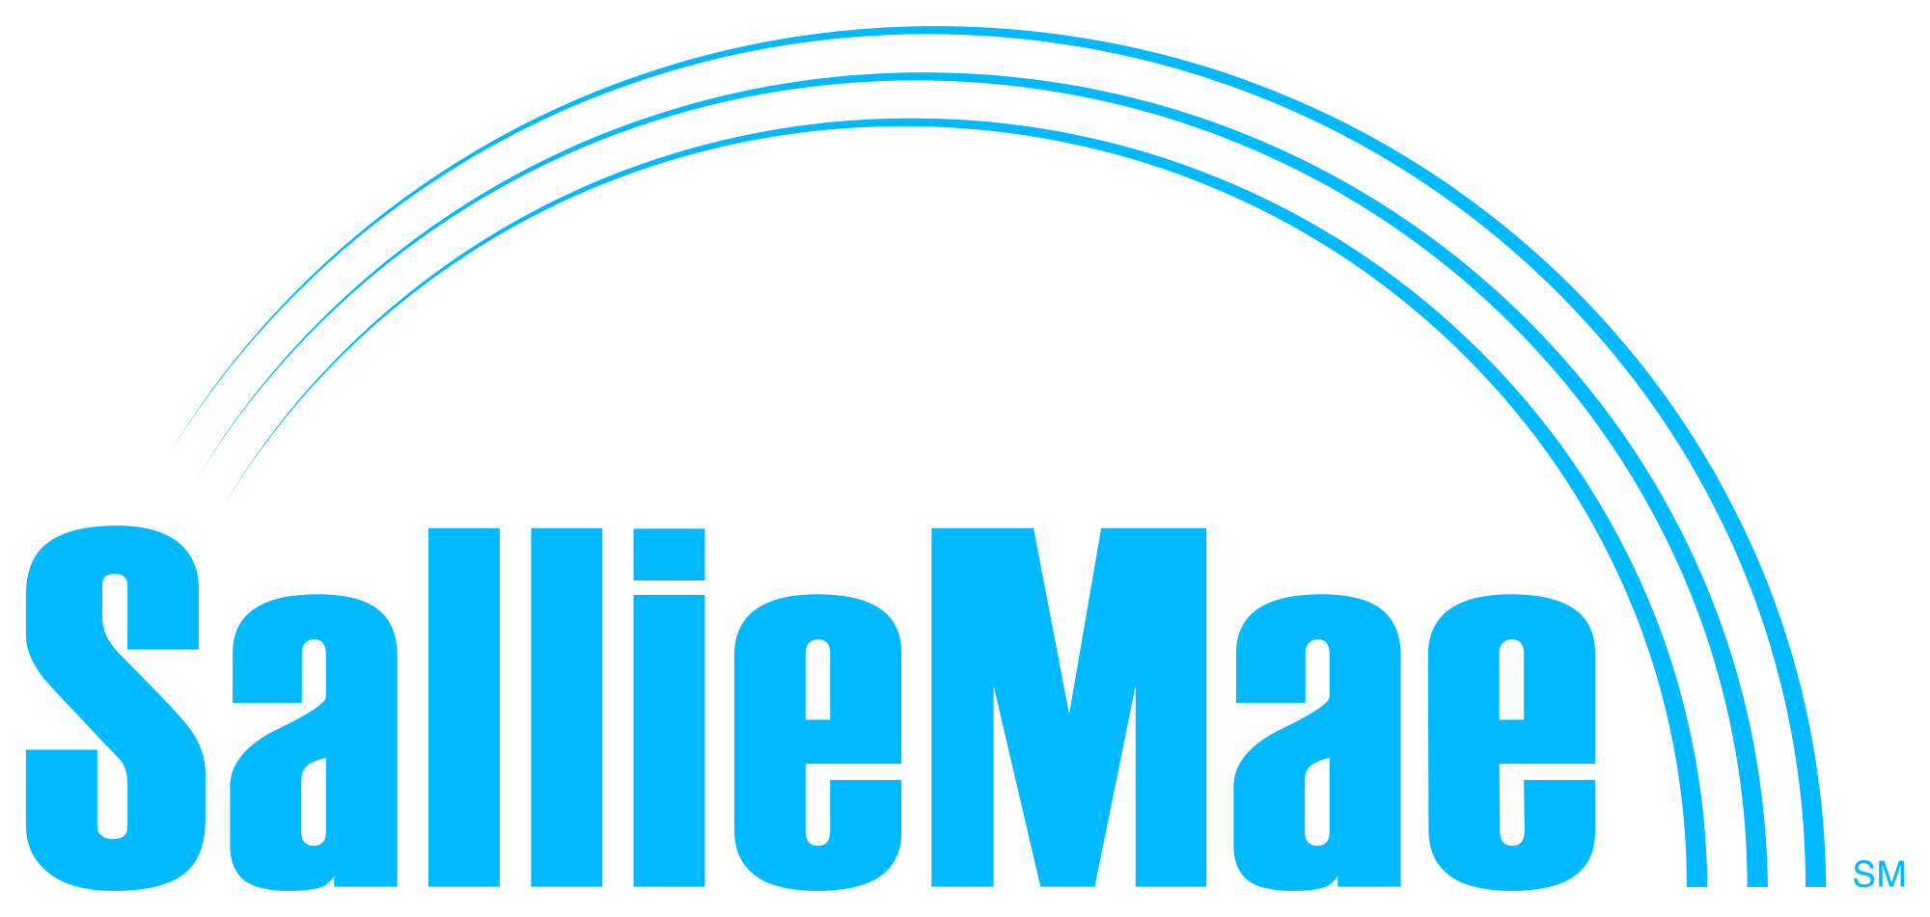



























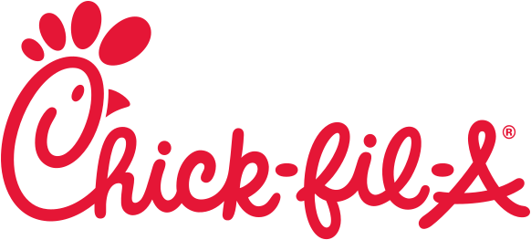



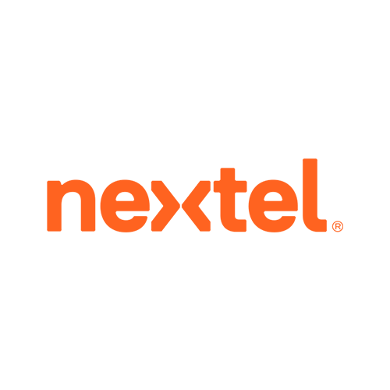
Internal and external customers across industries

Slide 5
Customers tell us they need to:
Build organizations, processes and systems that enable rapid innovation and delivery of high performing digital solutions for their customers.
Gain ‘how-to’ knowledge, grounded in real-world practice.
Notes:
Part of why we created The Amazon’s Builder Library is because customers tell us that they need to….
Build organizations, processes and systems that enable….
Gain how to knowledge, grounded in real-world practice so that they can quickly learn, build skills, high performing teams for their customers’ benefit.
And some of the more common questions we hear from customers are: “How does Amazon do things?” How does Amazon architect for reliability and fault tolerance? How does Amazon rapidly deliver software at scale? How do you create a DevOps culture?
We have take the opportunity in forums such as: re:Invent, DevOps Days at our Lofts and through conversations with several customers, to share our lessons learned and what’s worked for us to help answer some of these needs and questions. Yet, we feel that we can do more to share….
<CLICK>

Slide 6
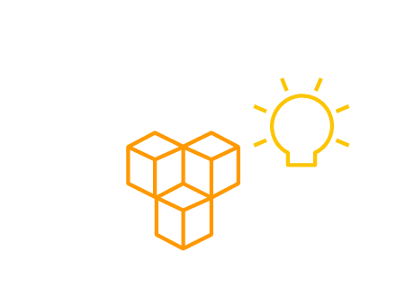
The Amazon Builders’ Library
How Amazon builds and operates software
Architecture, software delivery, and operations
By Amazon’s senior technical executives and engineers
Real-world practices with detailed explanations
Content available for free on the website
Notes:
The Amazon Builders’ Library is a collection of living articles and videos that give readers a look under the hood at how Amazon builds and operates the technologies that underpin Amazon.com and AWS. The Builders’ Library content is written by the senior technical executives and engineers who are responsible for that topic on a daily basis and dives deep into the real-world practices used by Amazon every day. At launch, there are over a dozen articles. The launch of this website today is just the beginning. We’ve got many more articles and soon videos on the way. We’ll be releasing new content regularly going forward. We’re sharing our history and our lessons but this won’t be a one way street. We’ll also be collaborating with customers, partners, and listening and learning from others too. We are covering content across architecture, software delivery, and operations. I’ve included at least one example of each here. Architecture focuses on the design decisions used when building a cloud service to optimize for security, durability, high availability, and performance. Software delivery and operations covers the process of releasing new software to the cloud and maintaining the health and availability of that software for its customers. The topics in this area have high overlap with concepts frequently associated with “DevOps.”
To see an example of each topic, let’s move to the next slide.

Slide 7
A Point of Reference: ‘First hand’ Lessons & Techniques
Architecture
Software Delivery & Operations
Curated articles to help you modernize and transform your business in the cloud
Deep dive insights into practices that have worked well at Amazon and those that haven’t
Notes:
We’re excited to share this library, freely accessible to everyone, and no AWS account is required. It’s a place we share “how we do it” at Amazon, a place that exposes an increasing depth and breadth across subjects. With The Amazon Builders’ Library, Amazon is sharing lessons learned from over 20 years building and running software. Engineers, architects, operators, and managers from companies of all sizes can use The Builders’ Library as a point of reference when making decisions about their own culture, processes, and architecture. The site is currently organized into three categories:
Architecture: challenges with distributed systems, inproving latency and availability with caching, architecting to use multiple AZ’s for high availability and ensuring systems are statically stable
Culture: some of the key areas covered include: Amazon’s culture of ownership, Amazon’s Evolving culture and Lessons Learned from Amazon’s change in culture
Software Delivery: topic areas cover, Why Amazon does pessimistic deployments, measure everything, incident management at Amazon, build automation, creating pipelines and more!
The Builders’ Library provides content appropriate for technical employees at multiple levels of an organization, from software developer to CTO. It includes practices that Amazon tried that didn’t work well in a particular situation, to help readers avoid similar pitfalls. Also, The Builders’ Library’s authors dive deep into the subtleties of the conditions that led to Amazon’s decisions, helping readers consider whether Amazon’s approach is appropriate for their situation.
The Builders’ Library is a description of Amazon’s current best practices that work for Amazon.
To reiterate from an earlier part of our discussion- We believe that there is no one right way to build software. We hope that customers will find The Builders’ Library valuable. However, what works for Amazon may not be ideal for every company or situation. Even within Amazon, teams implement different optimal practices based on the situation, constraints, and the needs of their customers. Amazon is constantly changing and what is a best practice today may not be the best practice tomorrow.
So how did Amazon come up with these best practices? It may be worth taking a few minutes to share our story, to provide context into what motivated and drove us in our pursuit to achieve software engineering excellence.
<CLICK>

Slide 8
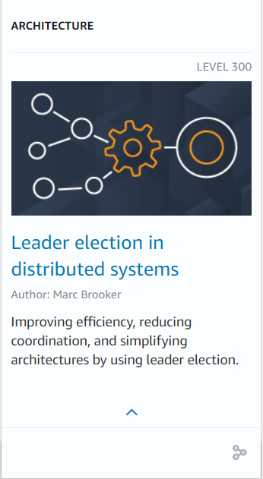
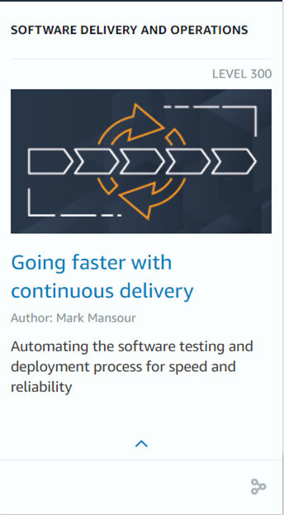
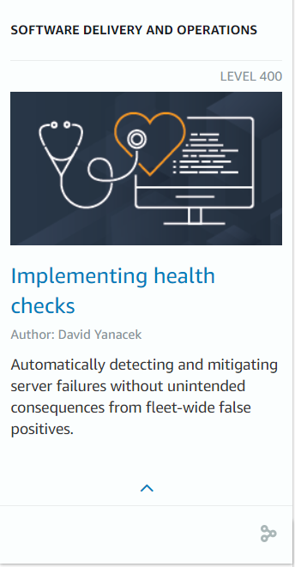
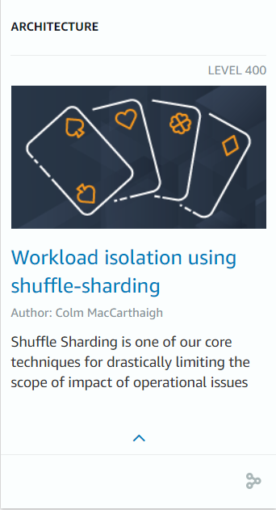
The Amazon Builders’ Library
Many more at aws.amazon.com/builders-library
Notes:
I want to provide an example of each type of content. The first Architecture example is “Leader election in distributed systems.” Leader election is the idea of giving one thing (a process, a host) in a distributed system some special powers, such as the ability to assign work or modify a piece of data. Leader election is a powerful tool we use within Amazon for improving efficiency, simplifying architectures, and reducing operations. However, it can come with additional risks and potential for failure. This article discusses the pros and cons for different scenarios and provides insight into Amazon’s best practices for using leader election.
The culture example “Delivering across two pizza team organization” addresses one of the most common questions we get asked after we’ve explained two pizza teams. That is, “how does Amazon coordinate hundreds or thousands of two pizza teams? What are the mechanisms and guardrails used to make sure every team is independent enough to move fast and innovate but also ensure they go in the right direction. This article gives insight into how we manage that challenge.
The software delivery and operations example is “Implementing health checks,” which discusses how Amazon uses health checks to detect and deal with single-server failures, the things that happen when health checks are not used, and how systems that overreact to health check failure can turn small problems into complete outages.
Go to aws.amazoncom/builders-library to check it out today and look out for our community discussions on reddit and twitch.
(In case you need it: Using caches successfully discusses the benefits and challenges of caching in the course of building and operating services at Amazon. The article describes our lessons learned, best practices, and considerations for using caches.)

Slide 9
Lessons learned at Amazon for developing and delivering software
Decompose for agility (microservices, 2-pizza teams)
Automate everything
Standardized tools
Belts and suspenders (governance, templates)
Infrastructure as code

Slide 10
Key takeaways
“This is [our] way”
Our way is NOT the only way
It’s about real problems, direct from the engineers who solved them
Every customer, regardless of industry or scale, can benefit from these learnings

Slide 11
Amazon’s Journey

Slide 12
Our mission
Our task was to improve:
Innovation
Speed
Agility
Safety
What we did:
Decomposed for agility
Cultural and operational shift
Created tools for software delivery

Slide 13
Just starting out
This is how many web architectures started out, and it’s how Amazon started too…
There any many bottlenecks, and scaling of the web server was an immediate factor

Slide 14
Scaling v1
In 1998 the “Distributed Computing Manifesto” came out and we began breaking things down into separate components… This was a bit better, still not very scalable

Slide 15
Going further
Principles
Make units a small as possible (Primitives)
De-couple based on scaling factors, not functions
Each service operates independently “Communication is terrible!” —Jeff Bezos
APIs (contracts) between services

Slide 16
Impact to our development

Slide 17
Monolith development lifecycle

Slide 18
Monolith development lifecycle

Slide 19
Monolith development lifecycle
This led to changes in organization
Build
Test
Release
Monitor
Build
Test
Release
Monitor
Build
Test
Release
Monitor
Build
Test
Release
Monitor
Build
Test
Release
Monitor
Build
Test
Release
Monitor

Slide 20
Impact to our organization

Slide 21
Getting (re)organized
“Two-pizza” teams
Own a service
Minimizes social constraints (Conway’s law)
Autonomy to make decisions

Slide 22
Transformation timeline
2001
2002
Monolithic application + teams
Microservices + 2-pizza teams

Slide 23
Teams Own Everything
“Two-pizza” teams
Own a service
Minimizes social constraints (Conway's law)
Autonomy to make decisions
Planning
Security
Performance
Scalability
Deployment
Operation
Bugs
Documentation
Testing…
How can one team do all of this?

Slide 24
Key takeaways
Customers who want to go faster, safer, need to think smaller, more independent
This IS achievable in a relatively short time
Top-down leadership is critical
Encourage your customer to Think Big and caution them not to sub-optimize

Slide 25
Now we have…

Slide 26
Modern Applications
Today we have Modern Applications
Use independently scalable microservices (serverless, containers...)
Connect through APIs
Deliver updates continuously
Adapt quickly to change
Scale globally
Are fault tolerant
Carefully mange state and persistence
Have security built-in

Slide 27
Measuring success

Slide 28
How we think about metrics
Business metrics
Operational metrics
Input goals
Enablement
Growth
Errors
Features
Principal reviews
Usage
Throttling
Use cases
Security training
Feedback
Failed deployments
Performance
Ops training
Performance

Slide 29
Enabling our teams through automation

Slide 30
Software delivery at Amazon
Dev/Test
Code review
Pre-production
testing
Production
Notes:
At a very high level, this is what our software delivery lifecycle looks like at Amazon. We’ll get into a lot more detail later.
Like most organizations we have a dev/test loop that the individual developer manages.
Then, we build and test the code again as it goes off to a code review with a senior engineer for all changes
After that, the change is tested in various pre-production environments.
Finally it is released into production. We’ll go a lot deeper into these last two phases later.
A couple things we think about.
1st. We want everything to be as automated as possible because we find it increases velocity and reduces errors. We add automation at every stage of the process and both the pre-prod and prod phases are fully automated.
2nd We repeat lots of things such as testing throughout. We want to catch things as early in the process as possible as the cost goes up when you catch things later. To illustrate this point…

Slide 31
Software delivery at Amazon
Code review
Pre-production
testing
Production
Dev/Test

Slide 32
Dev/Test
Gating Function
Works on smallest thing possible
Only local code branches
Develops and tests locally
Explicitly defines dependencies (including those needed for testing)
Publishes changes for review
AWS CodeCommit
Developer (or cloud)
workstation
Developer AWS account
Code review
This part should be fast

Slide 33
Key takeaways
Ask your customer about how their developers work
It’s a creative process, removing constraints is the key to unlocking innovation
This is an opportunity to position products like Cloud9, CDK, and talk about account design

Slide 34
Continuous Delivery at Amazon
Dev/Test
Code review
Pre-production
testing
Production

Slide 35
Amazon Continuous Delivery: Deep Dive
Source

Slide 36
Amazon Continuous Delivery: Deep Dive
Source
Build

Slide 37
Amazon Continuous Delivery: Deep Dive
Source
Build

Slide 38
Amazon Continuous Delivery: Deep Dive
Source
Build
alpha
Automated tests
Pre-production

Slide 39
Amazon Continuous Delivery: Deep Dive
Source
Build
alpha
beta
Automated tests
Automated integration tests
Automated load/perf tests
Automated browser tests
Pre-production

Slide 40
Amazon Continuous Delivery: Deep Dive
Source
Build
alpha
beta
gamma
Automated tests
Automated integration tests
Automated integration tests
Automated load/perf tests
Automated synthetic tests
Automated browser tests
API smoke tests
Pre-production

Slide 41
Amazon Continuous Delivery: Deep Dive
Source
Build
alpha
beta
gamma
Automated tests
Automated integration tests
Automated integration tests
Automated load/perf tests
Automated synthetic tests
Automated browser tests
API smoke tests
Pre-production
Production

Slide 42
Amazon Continuous Delivery: Deep Dive
Source
Build
alpha
beta
gamma
Automated tests
Automated integration tests
Automated integration tests
Automated load/perf tests
Automated synthetic tests
Automated browser tests
API smoke tests
Pre-production
Production

Slide 43
Amazon Continuous Delivery: Deep Dive
Source
Build
alpha
beta
gamma
Automated tests
Automated integration tests
Automated integration tests
Automated load/perf tests
Automated synthetic tests
Automated browser tests
API smoke tests
Pre-production
Production

Slide 44
Amazon Continuous Delivery: Deep Dive
Source
Build
alpha
beta
gamma
Automated tests
Automated integration tests
Automated integration tests
Synthetic Monitoring
Automated load/perf tests
Automated synthetic tests
Automated browser tests
API smoke tests
Pre-production
Production

Slide 45
Amazon Continuous Delivery: Deep Dive
Source
Build
alpha
beta
gamma
Automated tests
Automated integration tests
Automated integration tests
Synthetic Monitoring
Synthetic Monitoring
Automated load/perf tests
Automated synthetic tests
Automated browser tests
API smoke tests
Pre-production
Production

Slide 46
Amazon Continuous Delivery: Deep Dive
Source
Build
alpha
beta
gamma
Automated tests
Automated integration tests
Automated integration tests
Synthetic Monitoring
Synthetic Monitoring
Automated load/perf tests
Automated synthetic tests
Automated browser tests
API smoke tests
Synthetic Monitoring
Pre-production
Production

Slide 47
Amazon Continuous Delivery: Deep Dive
Source
Build
alpha
beta
gamma
Automated tests
Automated integration tests
Automated integration tests
Synthetic Monitoring
Synthetic Monitoring
…
Automated load/perf tests
Automated synthetic tests
Automated browser tests
API smoke tests
Synthetic Monitoring
Pre-production
Production

Slide 48
Amazon Continuous Delivery: Deep Dive
Source
Build
alpha
beta
gamma
App code
Automated tests
Automated integration tests
Automated integration tests
Synthetic Monitoring
Synthetic Monitoring
Infrastructure as code
…
Automated load/perf tests
Automated synthetic tests
OS patching
Automated browser tests
API smoke tests
Synthetic Monitoring
Configuration
Pre-production
Production

Slide 49
Pipeline Blockers: time windows, pipeline policies, code coverage, code review, security scans, dependency updates, etc.
Source
Build
alpha
beta
gamma
App code
Automated tests
Automated integration tests
Automated integration tests
Synthetic Monitoring
Synthetic Monitoring
Infrastructure as code
…
Automated load/perf tests
Automated synthetic tests
OS patching
Automated browser tests
API smoke tests
Synthetic Monitoring
Configuration
Pre-production
Production

Slide 50
Fully automated: this part should be CAREFUL
Source
Build
alpha
beta
gamma
App code
Automated tests
Automated integration tests
Automated integration tests
Synthetic Monitoring
Synthetic Monitoring
Infrastructure as code
…
Automated load/perf tests
Automated synthetic tests
OS patching
Automated browser tests
API smoke tests
Synthetic Monitoring
Configuration
Pre-production
Production

Slide 51
Key takeaways
We know these patterns work and we built our tools to enable these patterns for our customers
We also (probably) integrate with what they already have
This is a place to position Code Suite, AWS Config, CDK/CloudFormation

Slide 52
Well-Architected + The Builders Library = Innovation Flywheel
Well-Architected is a tool composed of:
The Builders’ Library is a site composed of:
Architectural Pillars
Design principles
Asking Questions
Engineering practices
Service Patterns
Team norms and practices
Helps to find Answers

Slide 53
Just the beginning
Along the way we have learned a lot about writing software
That’s performant, safe, and scalable
We have had to solve some really hard problems
At massive scale
We know our way is not the only way, and many of our solutions are not fancy
But we know they work
We are long obsessed with building things to help our customers
Now we want to share the benefit of what we learned along the way

Slide 54
The Amazon Builders’ Library
How Amazon builds and operates software
Architecture, software delivery, and operations
By Amazon’s senior technical executives and engineers
Real-world practices with detailed explanations
Content available for free on the website
https://aws.amazon.com/builders-library
Notes:
The Amazon Builders’ Library is a collection of living articles and videos that give readers a look under the hood at how Amazon builds and operates the technologies that underpin Amazon.com and AWS. The Builders’ Library content is written by the senior technical executives and engineers who are responsible for that topic on a daily basis and dives deep into the real-world practices used by Amazon every day. At launch, there are over a dozen articles. The launch of this website today is just the beginning. We’ve got many more articles and soon videos on the way. We’ll be releasing new content regularly going forward. We’re sharing our history and our lessons but this won’t be a one way street. We’ll also be collaborating with customers, partners, and listening and learning from others too. We are covering content across architecture, software delivery, and operations. I’ve included at least one example of each here. Architecture focuses on the design decisions used when building a cloud service to optimize for security, durability, high availability, and performance. Software delivery and operations covers the process of releasing new software to the cloud and maintaining the health and availability of that software for its customers. The topics in this area have high overlap with concepts frequently associated with “DevOps.”
To see an example of each topic, let’s move to the next slide.

Slide 55
Why are you (still) here?
Now you can answer your customer (correctly) when they ask, “How does Amazon do it?”
You can build trust by sharing real stories
Your customers need advice to transform
Your customers are looking for patterns to adopt when they starting out
You want to talk to your customer about building better software
What was DevOps?
You have a way to accelerate your customers innovation
Chair was comfy, is this guy still talking?

Slide 56
Q&A
Name of presenter

